Slide 1


WELCOME

Slide 2
RELIANCE AMBIENT MEDIA ADVERTISING

Slide 3
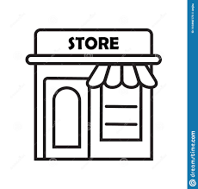


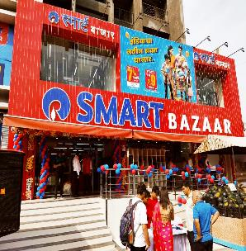



Engage with our grocery shoppers at scale leveraging the reach of
Reliance’s Smart Bazaar Network of stores across India
3800 + Stores across 1200 cities
18Mn+ Daily Footfalls
800 + Large Format Stores
(Greater than 10K sq ft)
Caters to all consumer segments - Neighborhood , Supermarket & Premium Stores across India
INR 1000+
Avg Order Value
1500+ stores in
Metro + Tier 1 (40%)
Neighbourhood Stores = SmartPoint, Supermarket Stores = SmartBazaar, Premium Stores = Fresh Signature/ Fresh Pik

Slide 4
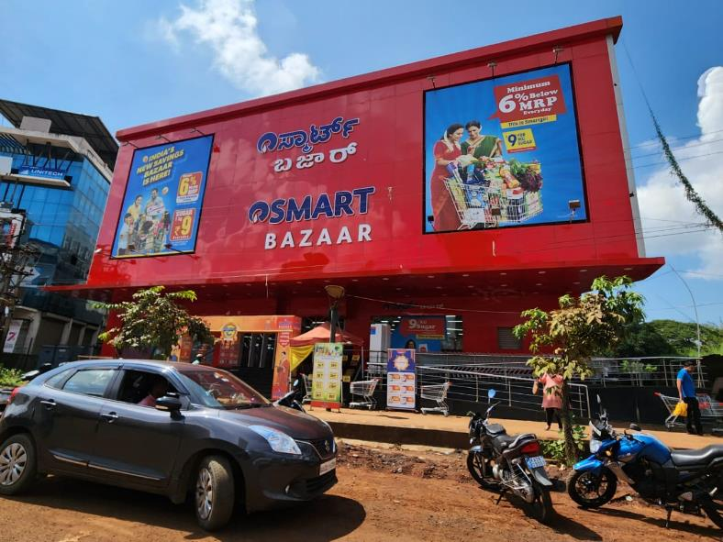
Store Hoardings
Available at all 800+ large format stores (>10k ft)
Maximize visibility of your brand amongst both shoppers entering the store as well as consumers passing by.
23Mn+ footfalls weekly (does not include consumers passing by)

Slide 5
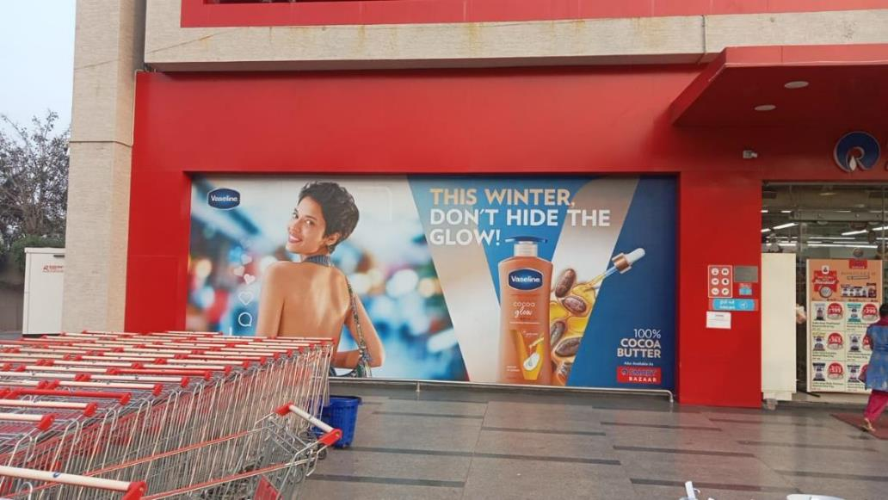
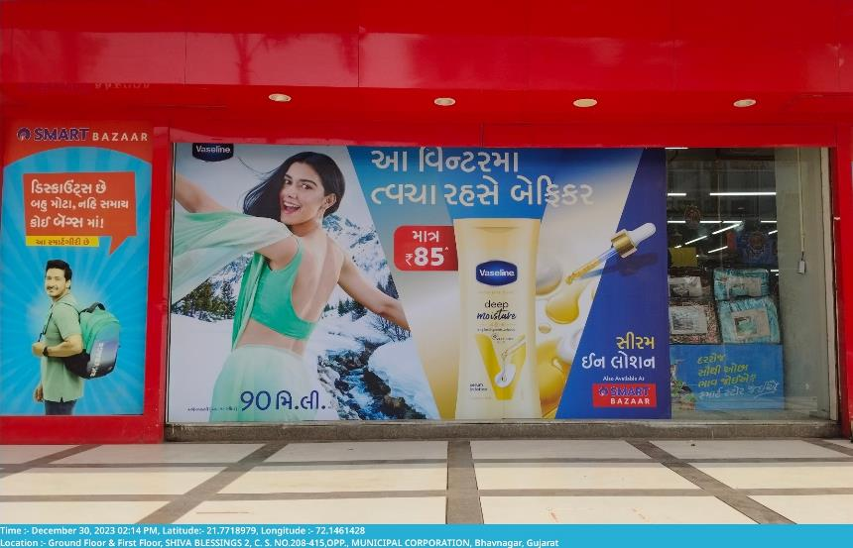
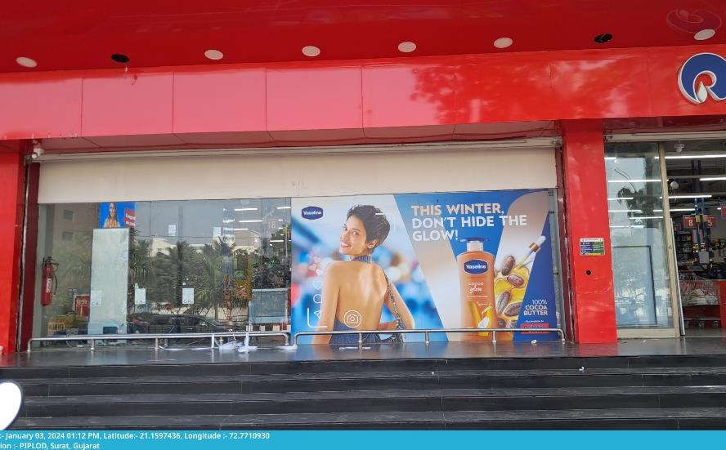
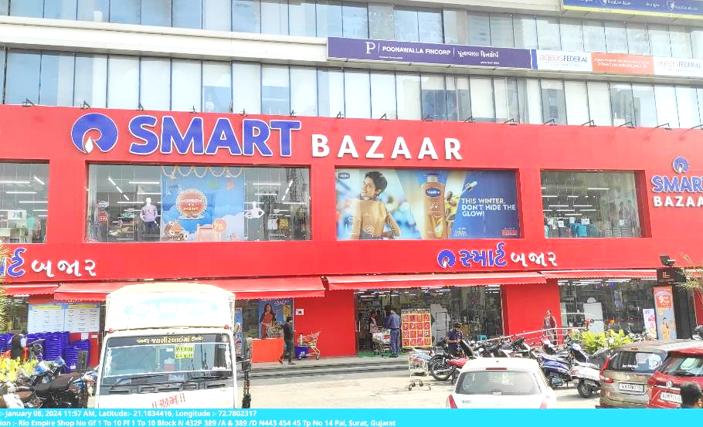
Glass Facade

Slide 6
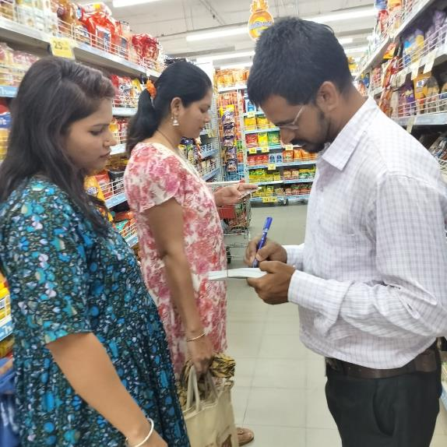
Promoter Activity – After Check Out Near Exit
Engage with Customers After Their Check Out before Exiting The Store
One to one interaction delivers personalized engagement, generates interest and resolves general queries by qualified promoters

Slide 7


Reliance Radio : Provide an enhanced in- store ambience and
shopping experience to your customers
Tell your brand story, communicate a promotional message or direct customers to your product across 3800+ stores
Reliance Radio is a centralized radio platform that streamlines the audio across stores
Broadcast your brand message to 18Mn+ consumers daily across stores ( even in cities where traditional radio does not reach)
*Audio Files – Pls move cursor on the icon to listen

Slide 8
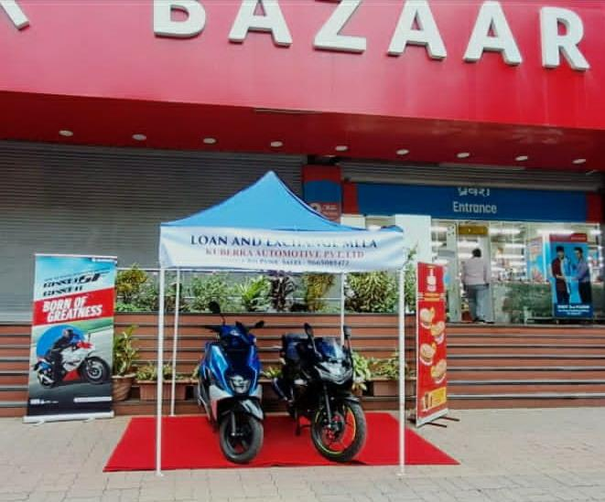
Outside Store: Podium Branding
Showcase your products leveraging the empty spaces
Feasibility depends on availability of empty space outside the store and can be ascertained once client finalizes the stores for the proposed activity

Slide 9
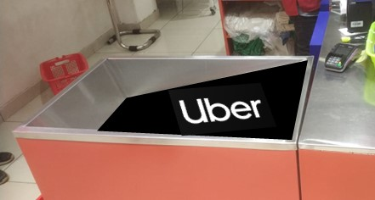
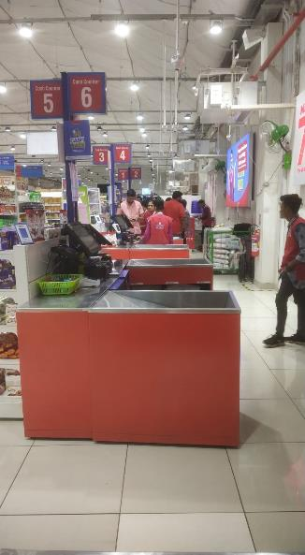
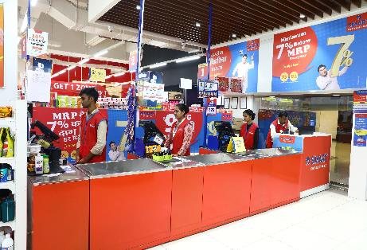
Point of payment : Continue to nudge your customers as they are
completing their shopping experience
Encouraging impulse buying at the check out counters
Place your brand here on side or top panels

Slide 10
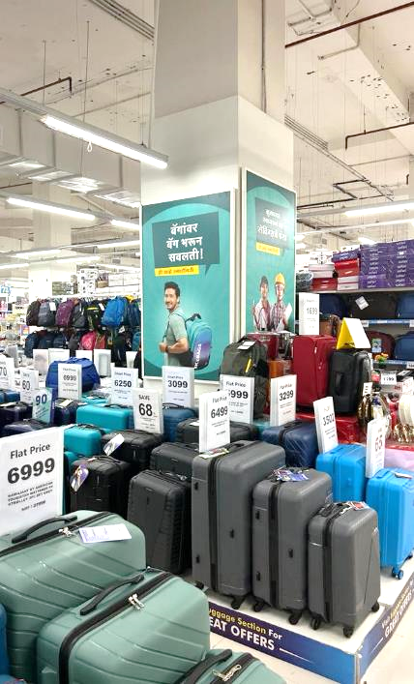
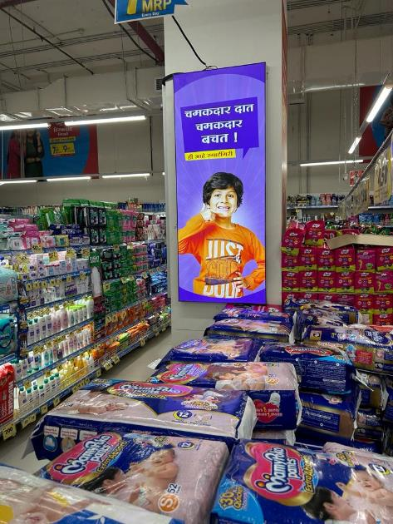
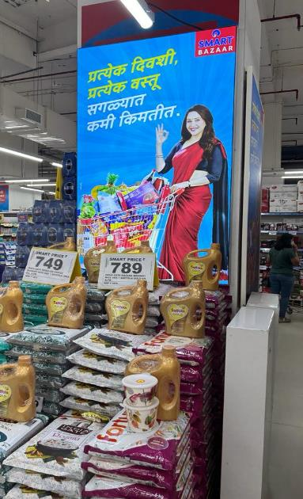
Pillar branding

Slide 11
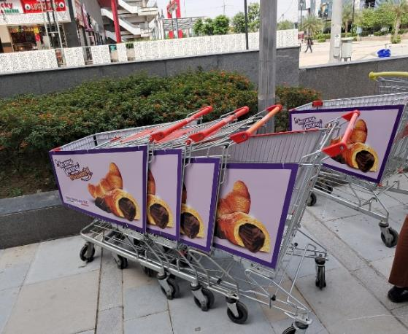
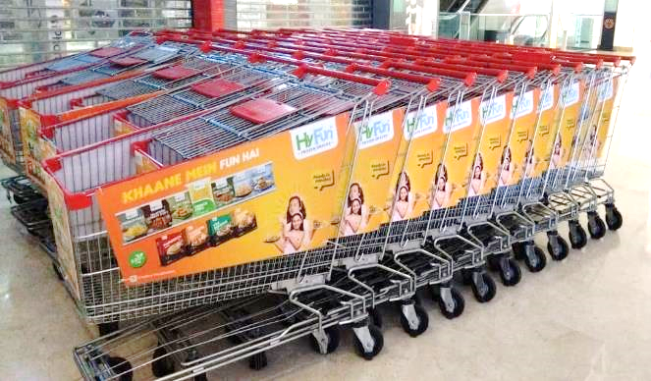
Trolley Branding

Slide 12
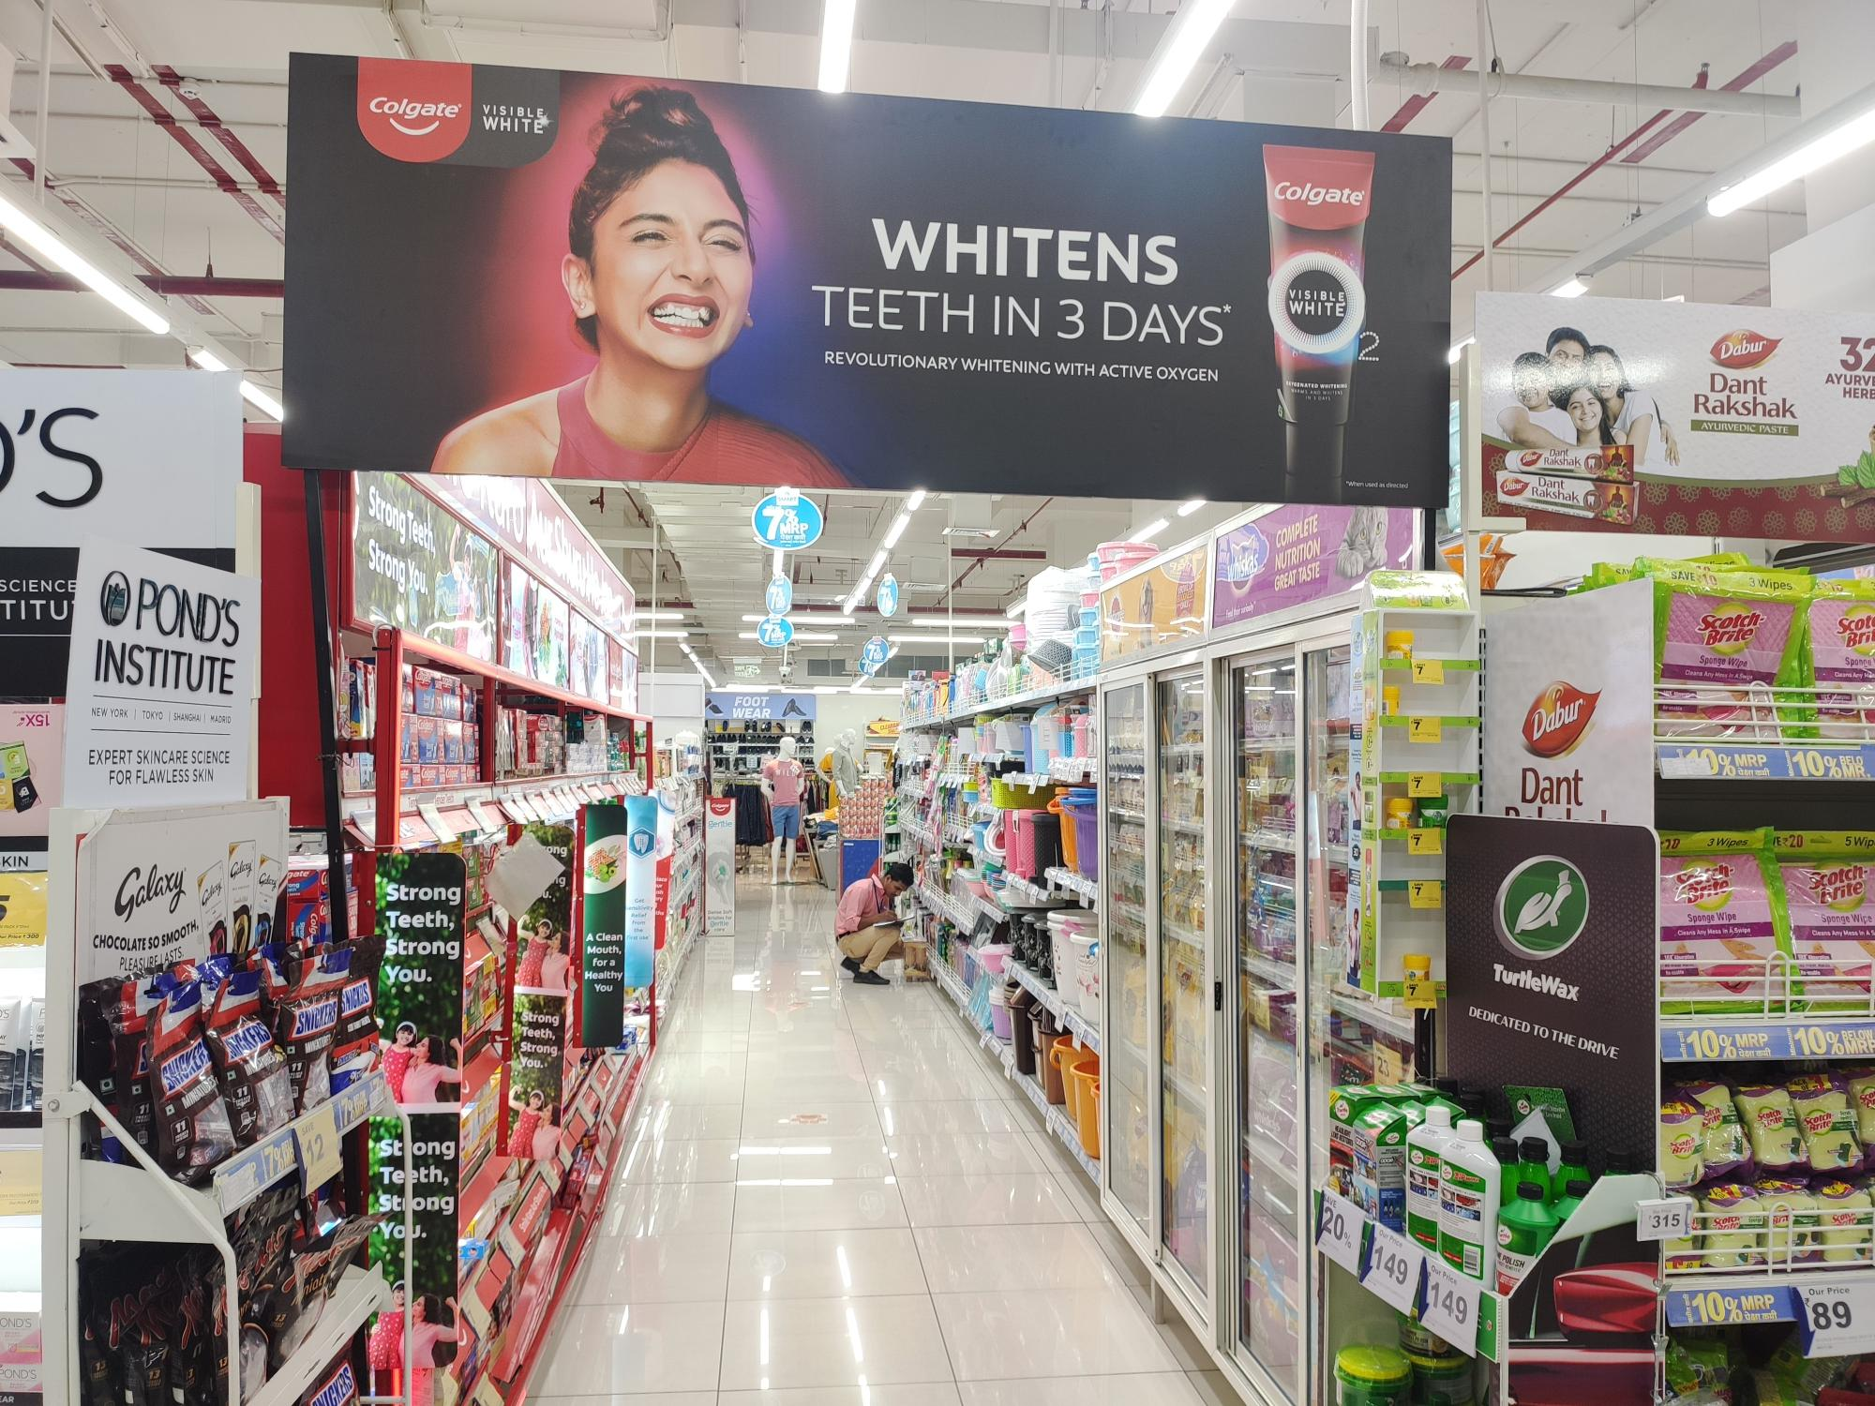
Category Arch Gate

Slide 13
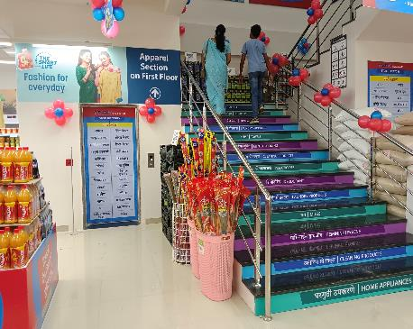
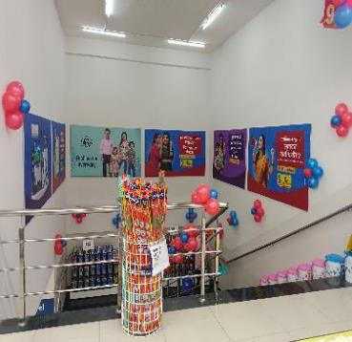
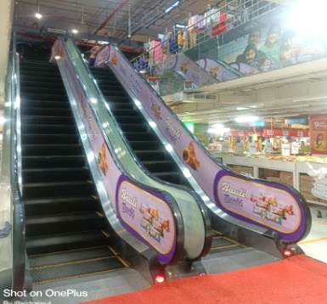
Inside Store : Multiple avenues to make your brand stand out as
consumers walk around the store…
Staircase, Elevator, Crew Branding

Slide 14


THANK YOU !
DHIRAJ CHABBRIA
Director - Marketing
Email Id : dc@sabmarcom.com
Mobile: +91 98700 79884

